Slide 1


EIOPA benchmarking of internal models + Allianz e documenti ufficiali
ALLIANZ GROUP

Slide 2





Fabio annicchiarico
Francesco paolucci
Christian polimeni
Elie ghazzoul
Robert Roman

Slide 3
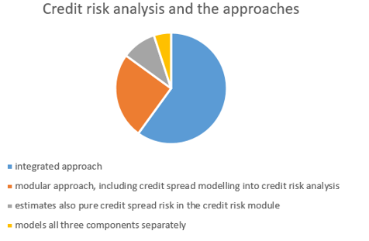
EIOPA’s Benchmark and the internal models
Banks and Insurance companies use these models to estimate risks that could occur. Relevant risks are the credit and the market ones. From those families, we distinguish other categories – default, migration, spread risk and interest rate, equity, property, currency – from the credit and market risks respectively.
In order to comply with the law, insurance companies had to create and establish an approach to manage those risks - the reference about law is the EIOPA-BoS-14/180.
Supervisors verifies every internal model and how they works (guidelines 12, 35), in particular for the calculation of the Solvency Capital Requirement and possible evolutions those model could have, during the time(guidelines 6-7-8). Those models are useful also for the same companies since the management can actively take decisions (guideline 11).
Fabio annicchiarico
Notes:
Sources:
EIOPA comparative study on market and credit risk modelling YE2021
Guidelines use of internal models.

Slide 4
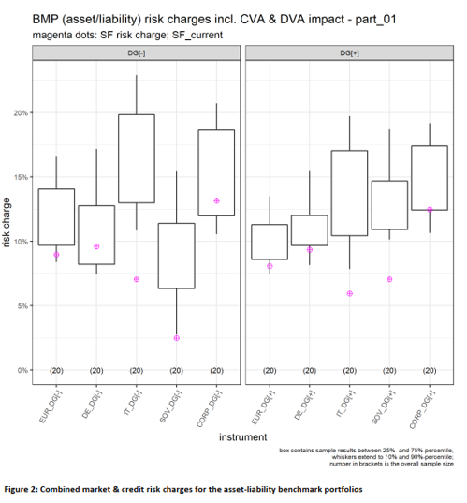
The benchmark portfolio and the risk dispersion
The BMP consider two point-of-views: from the asset side we have a linear combination of various instruments, firstly bonds and equities, chosen for their relations they share with real asset allocation in insurance sector, for different markets – DEU, BEL, ESP, FRA, IRL, ITA, NED and are used also to determine di VA, useful to estimate the credit spread risk.
On the other side, the liabilities – two are the position EIOPA considered: short and long.
The summary of those two points-of-views generated the A-L.BMP. The most important point we are looking for certainly is the risk charge, expressed in terms of dispersion: Italy has the most higher level (25-90% quartiles, whiskers included), even if the mean (the violet circles) is lesser than the corporate bonds risk.
Fabio annicchiarico
Notes:
Sources:
EIOPA comparative study on market and credit risk modelling YE2021
Guidelines use of internal models.

Slide 5
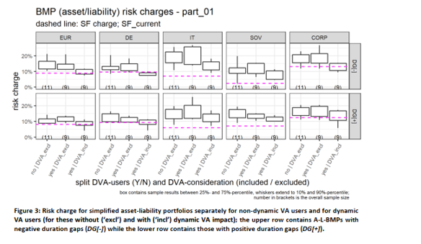
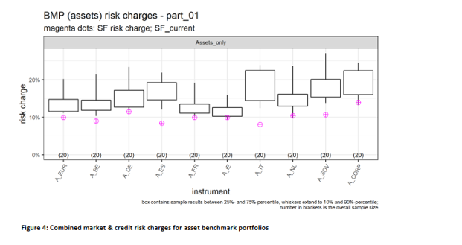
Dispersions from risk charges
These two graphs are useful since the first describes how much risk charge changes, given the different internal model insurance companies have adopted. We have already said that the credit spread risk involve the Volatility Adjustment; the first graph explain the risks in comparison with the models – the internal models using the dynamic VA has more dispersion than the constant VA. The second one explains the risk charges, given the asset portfolio whose variability has been calculated: the most important aspect is that the Italian asset portfolio shows a wider dispersion than the others, especially if we consider only the country-based assets.
Fabio annicchiarico
Notes:
Sources:
EIOPA comparative study on market and credit risk modelling YE2021
Guidelines use of internal models.

Slide 6
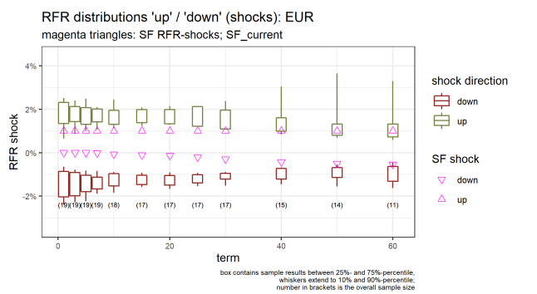
ABOUT INTEREST RISK
MAIN CORRELATIONS SHOWED BY THE STUDY ARE:
1. The longer is the maturity the fewer is the number of participants with an high exposition. For this aim the study provide an analysis of two portfolios with different durations, showing that the one with a higher duration is also the one with a higher associated risk.
2. The study highlights the necessity of shape the behavior of insurance companies in order to react to fluctuations on interest rate level
Francesco paolucci
Notes:
Sources:
EIOPA comparative study on market and credit risk modelling YE2021
Guidelines use of internal models.

Slide 7
ABOUT SPREAD RISK ON BONDS
RATING-RISK
MATURITY-RISK
Negative correlation between rating and risk. Bonds with higher rating are associated to lower risk. On the other side bonds with lower rating are associated to a higher risk
The study compares 5y bonds with 10y bonds showing a higher risk for the second type than the first type, especially for those firms using an integrated modelling approach.
Francesco paolucci
Notes:
Sources:
EIOPA comparative study on market and credit risk modelling YE2021
Guidelines use of internal models.

Slide 8
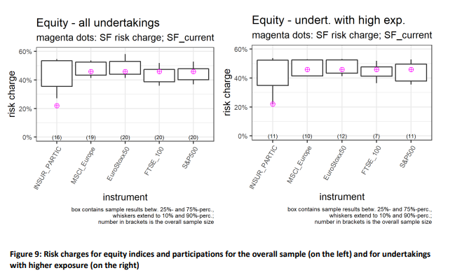
ABOUT EQUITY RISK
The last part of the study also analyses the risk associated with investments in equity.
The most important feature is that the associated risk is lower when the expositions are focused on big indexes like SP500 and FTSE100
Francesco paolucci
Notes:
Sources:
EIOPA comparative study on market and credit risk modelling YE2021
Guidelines use of internal models.

Slide 9
Stress-testing framework
Historic Stresses
Simulating market movements observed during specific stress periods
Parametric stresses
Reverse Stress Tests
involve standardized shocks on single or multiple risk factors
Identifying the severity level of a specific stress
Christian polimeni
Notes:
Sources:
Allianz group solvency and financial condition report 2021

Slide 10
RISKS
Market risk
Credit risk
Liquidity risk
Operational risk
THEME | MITIGATION MEASURE
collects premiums from policyholders and invests in various assets | Mitigation measures involve optimizing the portfolio through transactional, structural, and operational levers
Arises from its investment portfolio, credit insurance activities, and external reinsurance | Risk mitigation techniques include collateralization and careful selection of reinsurance partners
The liquidity risk is the potential inability to meet current or future payment obligations | Mitigation measures are in place, and in the event of limit breaches, escalation levels involve the intervention of the risk committee
Operational risks arise from inadequate or failed internal processes, human errors, system failures, and external events | Mitigation measures include specific control programs addressing compliance risks through written policies
Christian polimeni
Notes:
Sources:
Allianz group solvency and financial condition report 2021

Slide 11
Calculation of technical provisions
PROPORTIONALITY
MATERIALITY
EXPERT JUDGMENT
Determined by using data, assumptions and methods.
They have to consider the risk, scale and complexity
Valuation method, assumptions and data quality
Judgment is required in making additions or adjustments to estimates
ROBERT ROMAN
Notes:
Sources:
Allianz group solvency and financial condition report 2021

Slide 12
METHODS AND ASSUMPTIONS
ECONOMIC ASSUMPTIONS
TRANSITIONAL MEASURES ON TECHNICAL PROVISIONS
VOLATILITY ADJUSTEMNT
NON-ECONOMIC ASSUMPTIONS
01
02
03
04
Risk-free discount rates, market-consistent valuation methodology and inflation
Difference between the Solvency II technical provisions and the value of the liabilities based on previous regulations
For the unintended consequences of short-term volatility of capital requirements
Such mortality, morbidity, lapse rates and expenses
ROBERT ROMAN
Notes:
Sources:
Allianz group solvency and financial condition report 2021

Slide 13
Differences between the standard and any internall model
Internal models
Standard formula
 | we reflect the impact of the dynamic movement of the VA based on the credit spread movements of their own portfolio | Doesn’t contain a dynamic component to cover the impact of the VA applied on top of the risk-free interest rate curve
 | use an industry-standard approach based on Gaussian copulas. A correlation matrix defines the interdependencies between the risks modeled by the copula.
 | covers both longevity risks for pension obligations for employees and a new-business shock for the expense risk | neither of these risks are accounted for in the standard formula.
FOR valuation of technical provisions
For the aggregation of risks
For Non-Life underwriting risk
Small differences, The main differences between the internal model and the standard formula pertain to the modeling approach.
For Life/Health underwriting risk
ELIE GHAZZOUL
Notes:
For valuation of technical provisions, a volatility adjustment (VA) is applied on top of the risk-free interest rate curve. Therefore, the internal model contains a dynamic component to cover this impact. Allianz’s approach to model the dynamic component differs methodologically from the static EIOPA VA concept applied in the standard formula. In our risk capital calculations, we reflect the impact of the dynamic movement of the VA based on the credit spread movements of our own portfolio. This asset-sided effect is transferred to the liability side by using asset and liability durations. To account for deviations with respect to the EIOPA VA methodology, Allianz applies a more conservative, reduced application ratio for the dynamic volatility adjustment. A regular validation is performed to verify the appropriateness and prudency of the approach.
For the aggregation of risks, we use an industry-standard approach based on Gaussian copulas. A correlation matrix defines the interdependencies between the risks modeled by the copula. Wherever possible, we derive correlation parameters for each pair of market risks through statistical analyses of historical data, considering observations over more than a decade. This is done by a dedicated internal committee – the Correlation Setting Committee – which combines the expertise of risk and business experts. The correlations are generally set to reflect the dependency between the full distributions of the factors the correlation refers to. The correlations describing the dependency between the full distributions are increased by a factor in case a particularly strong dependence in the tails (i.e., in extreme events) is assumed
Sources:
Allianz group solvency and financial condition report 2021

Slide 14
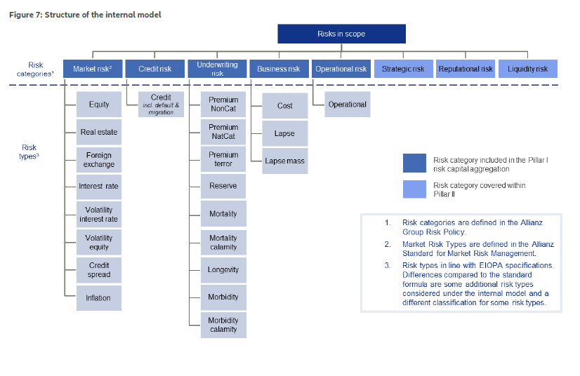
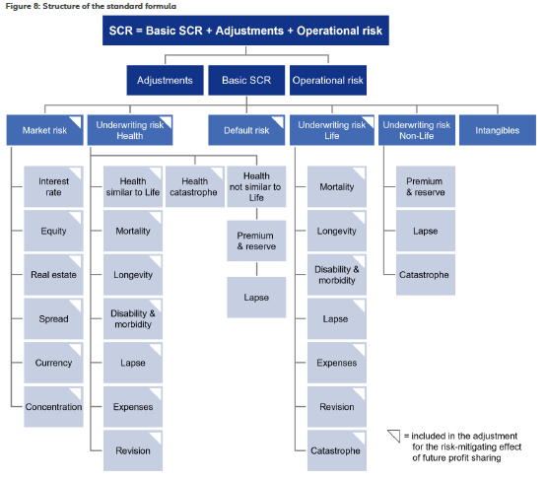
ELIE GHAZZOUL
Notes:
The photo on the left is the internal model
The photo on the right is the standard formula.
Sources:
Allianz group solvency and financial condition report 2021

Slide 15
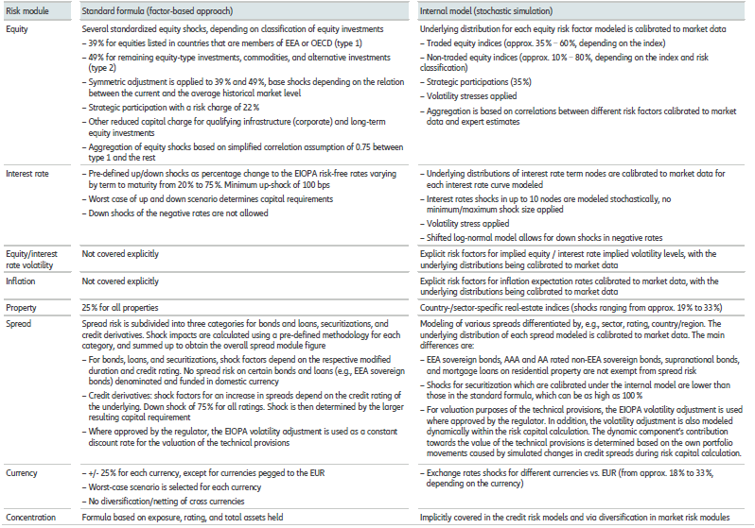
ELIE GHAZZOUL
Notes:
Sources:
Allianz group solvency and financial condition report 2021

Slide 16
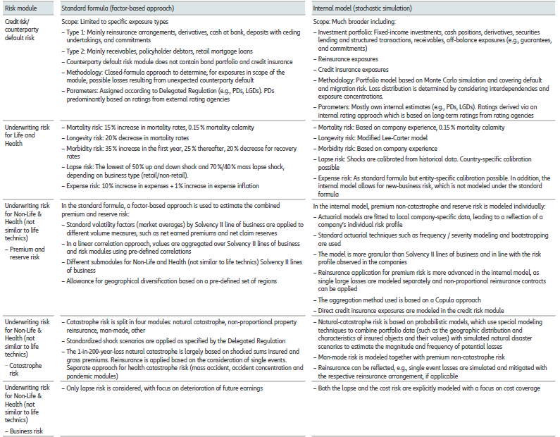
ELIE GHAZZOUL
Notes:
Sources:
Allianz group solvency and financial condition report 2021

Slide 17
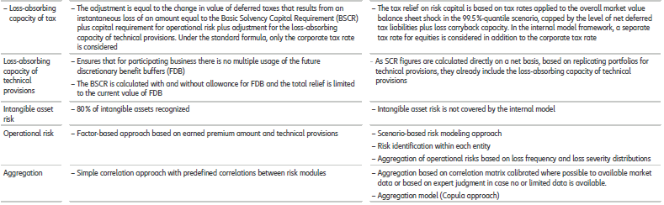
ELIE GHAZZOUL
Notes:
Sources:
Allianz group solvency and financial condition report 2021

Slide 18
Thank you for listening

